Slide 1
GROUP-3
Fresh Grads – Group Project
SHOPPING MALL MANAGEMENT SYSTEM
Group Members:
Gayathri S, T03030434
Amutha S, T030304342
Karthika K, T03043422
Kaniga S, T030304346
Harikumaran V, T030304340
Gokul J, T030304344

Slide 2
Problem Statement
In this project, we will be designing a simple shopping mall management system. The mall will provide a soothing shopping experience for customers, provide mall management functions to mall administrators and inventory/staff management to shop owners at the mall.
Mall Administrator:
The Mall Administrator is the super user and has complete control over all the activities that can be performed. The application notifies the administrator of all shop creation requests, and the administrator can then approve or reject them. The administrator can check the floor plan to see all the shops in the mall. The administrator can also get details about the mall employees.

Slide 3
Problem Statement
Shop Owner:
Any user can submit a shop creation request through the site. When the request is approved by the Mall Administrator, the requester is notified, and from there on is given the role of Shop Owner. The Shop Owner is responsible for setting up the shop and maintaining it. The job involves managing the inventory in the shop. Also, the shop owner can add or remove customers from his shop. The Shop Owner can also decide to close shop and remove it from the mall.
Mall Customer:
A Mall Customer can browse through the shops and choose products to place in a virtual shopping cart. The shopping cart details can be viewed and customers can be removed from the cart. Also, the customer can modify personal profile information (such as phone number and shipping address) store

Slide 4
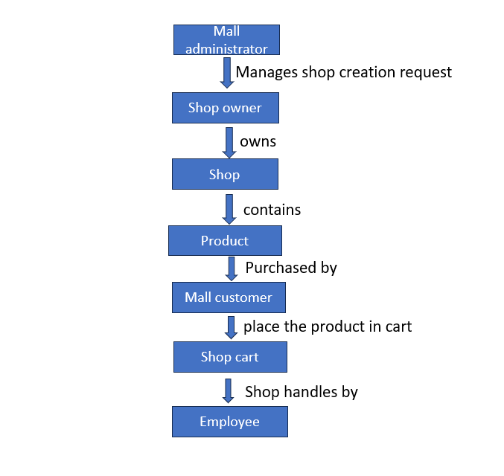
Road Map
Application will be developed in following Sprints –
Core Java
Springboot
Postgresql(creating database)
Postman API

Slide 5
Plan
Design
    For the shopping mall management system ,it
    consist of modules for managing and handing
    services
TDD approach
    Identify test cases for each module
    Write Failing Test cases
    Convert the Test Cases in GREEN
Implement the case study in incremental manner

Slide 6
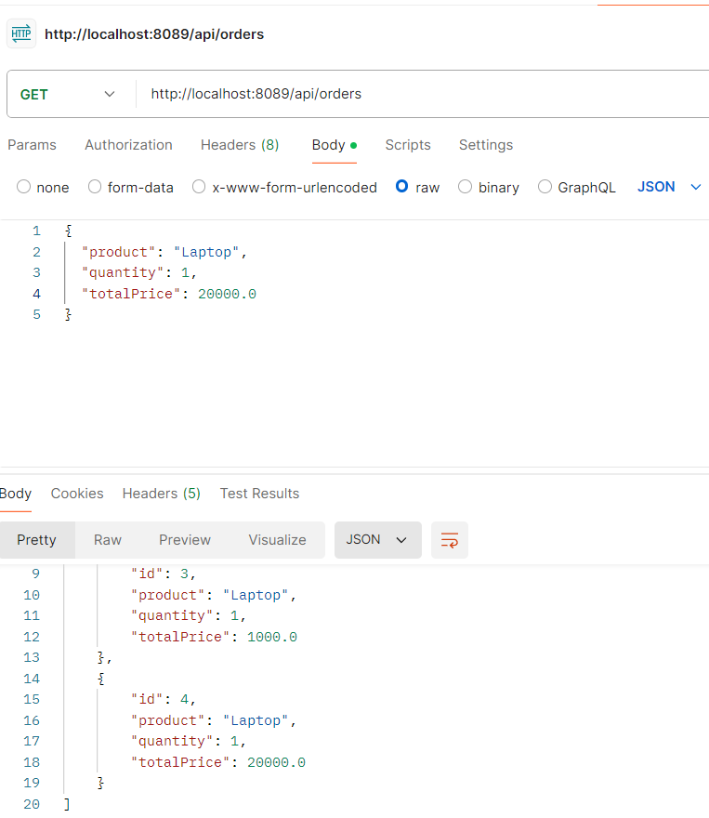
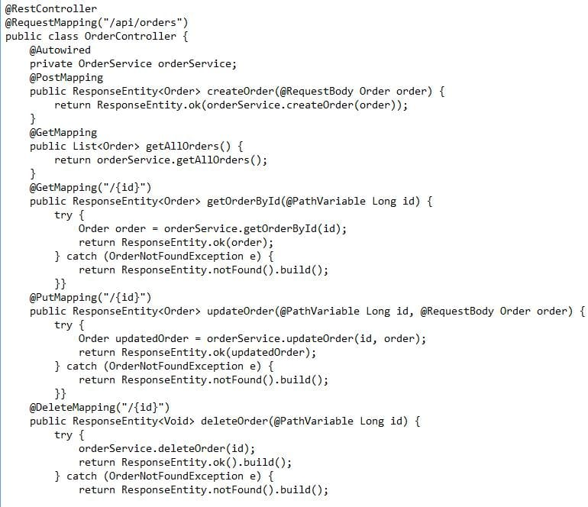
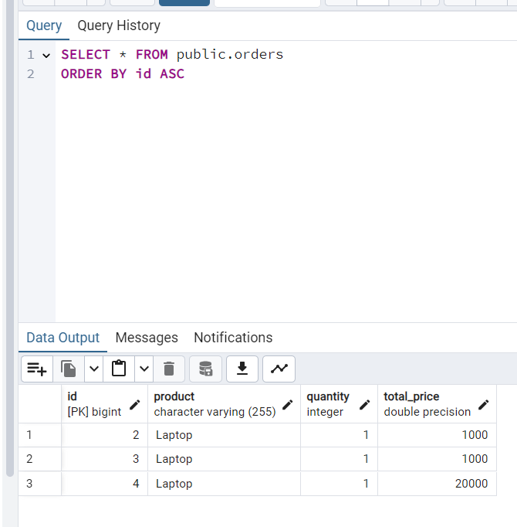
Order service

Slide 7
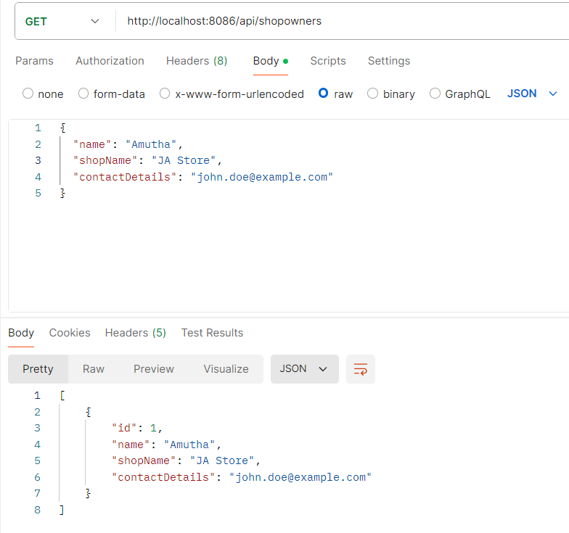
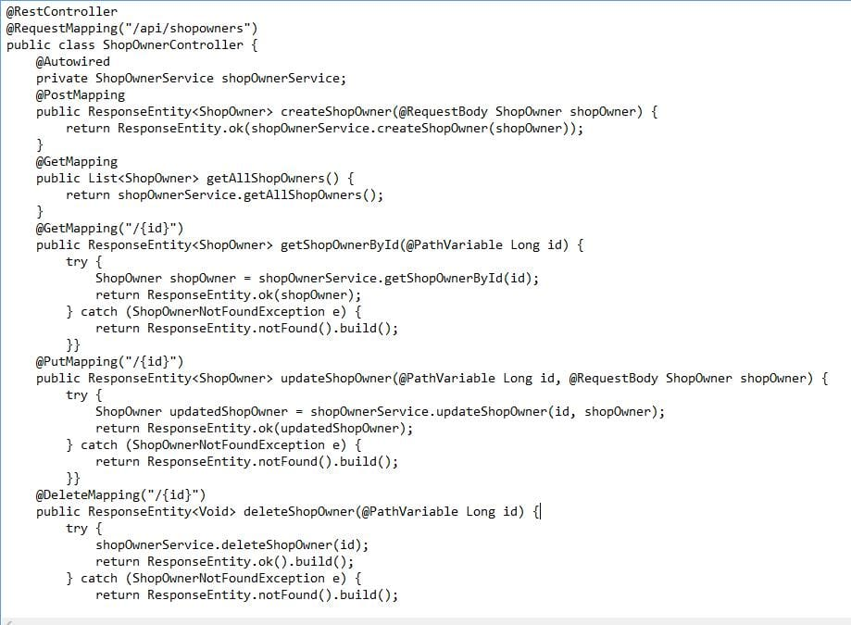
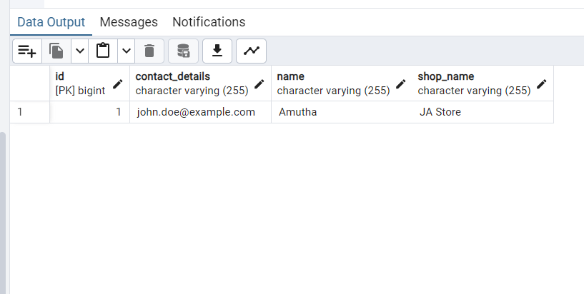
Shop owner Service

Slide 8
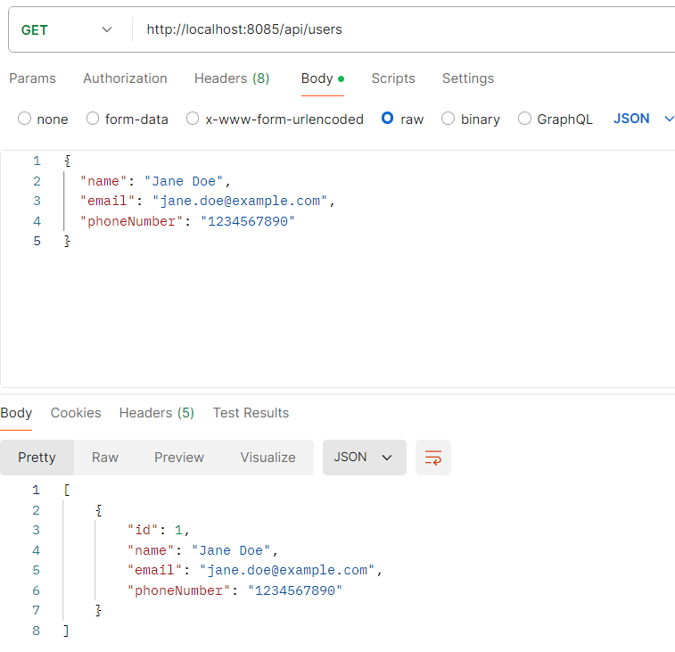
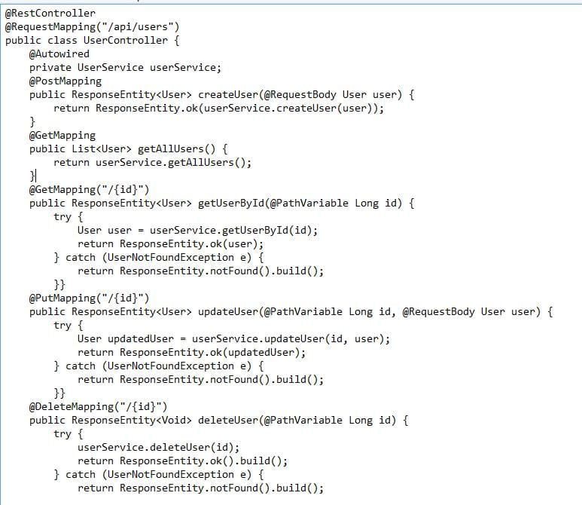
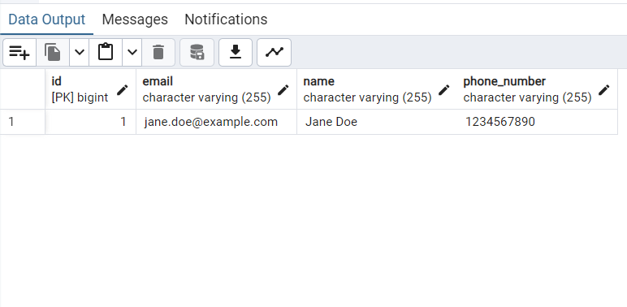
User service

Slide 9
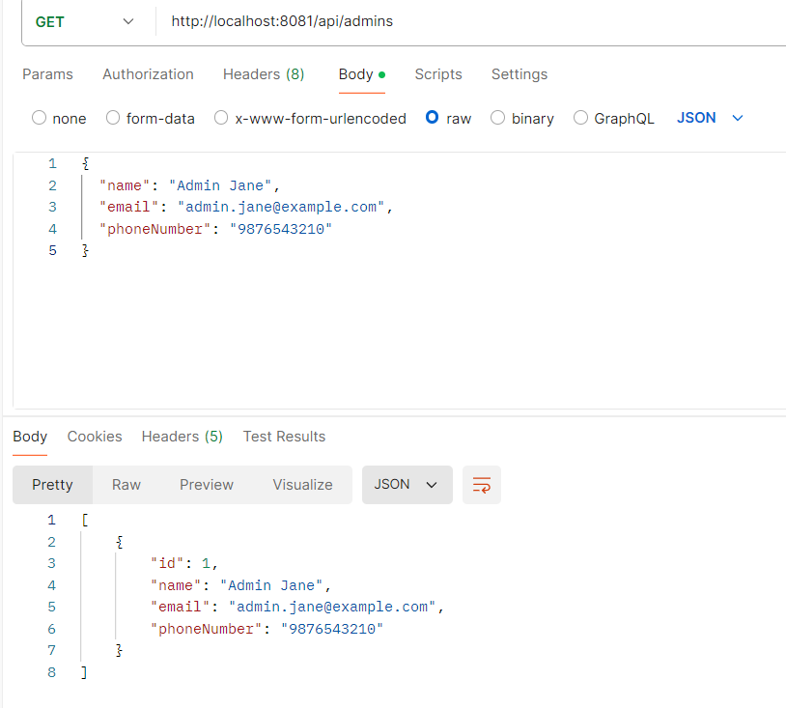
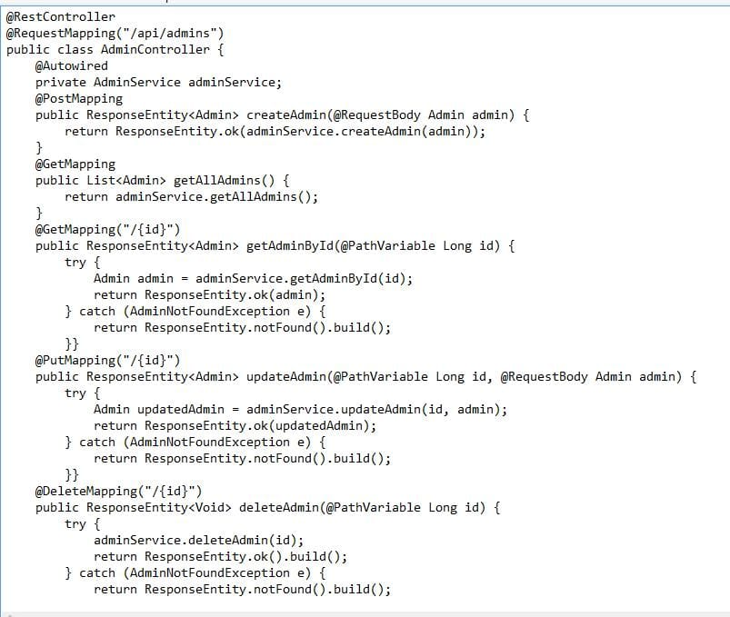
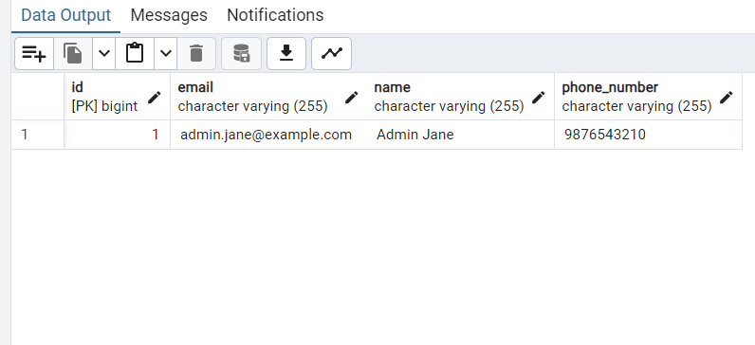
Admin service

Slide 10
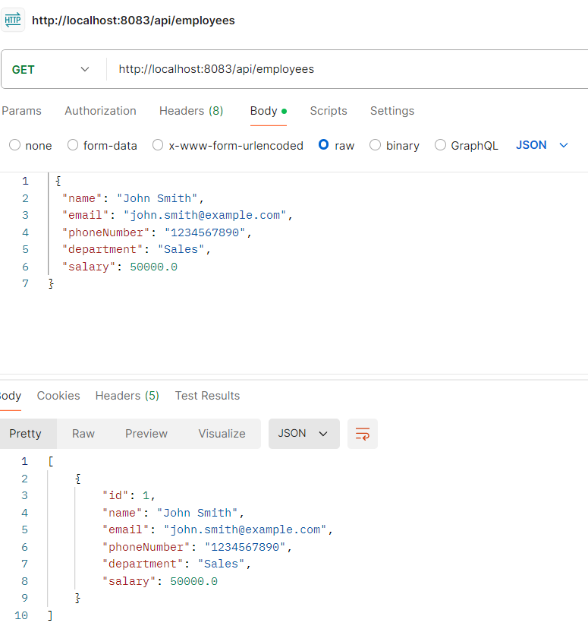
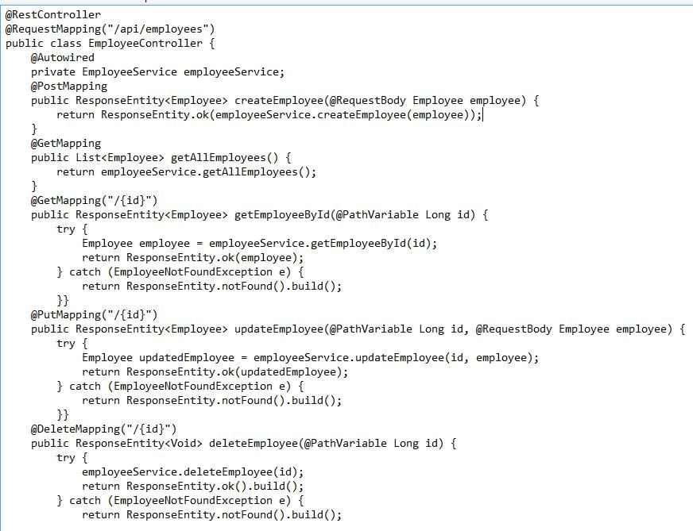
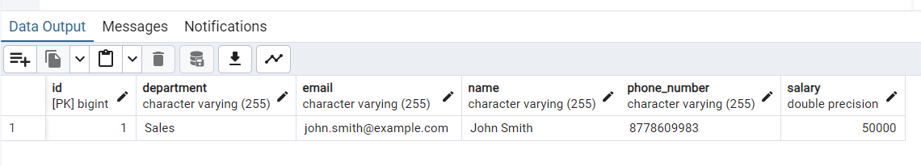
Employee service

Slide 11
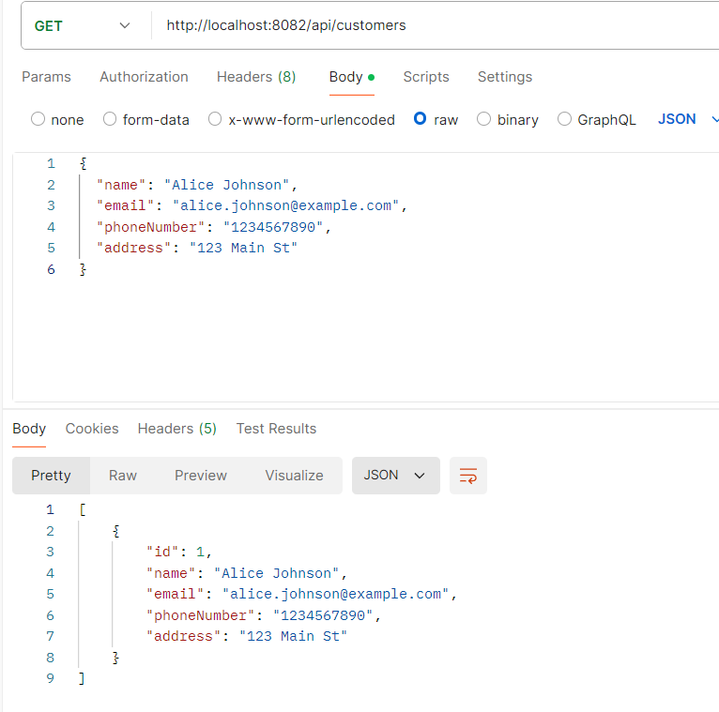
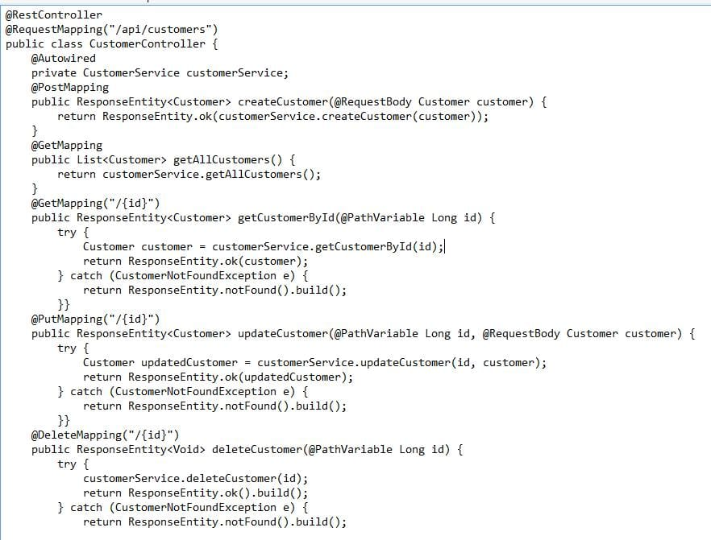
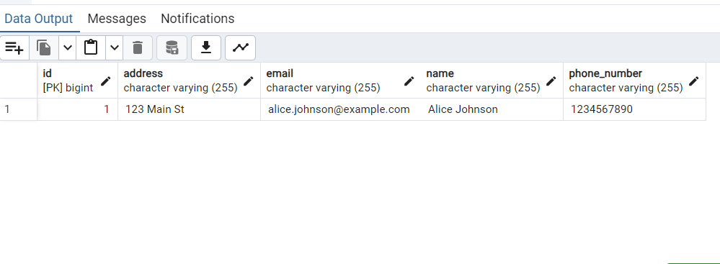
Customer service

Slide 12
THANK YOU

